Slide 1
Comparing Efficiencies of Ethanol and Fomepizole as Antidotes to Methanol Poisoning
Kushagra Agarwal
Akshit Garg
Antidotes being compared are Ethanol and Fomepizole

Slide 2
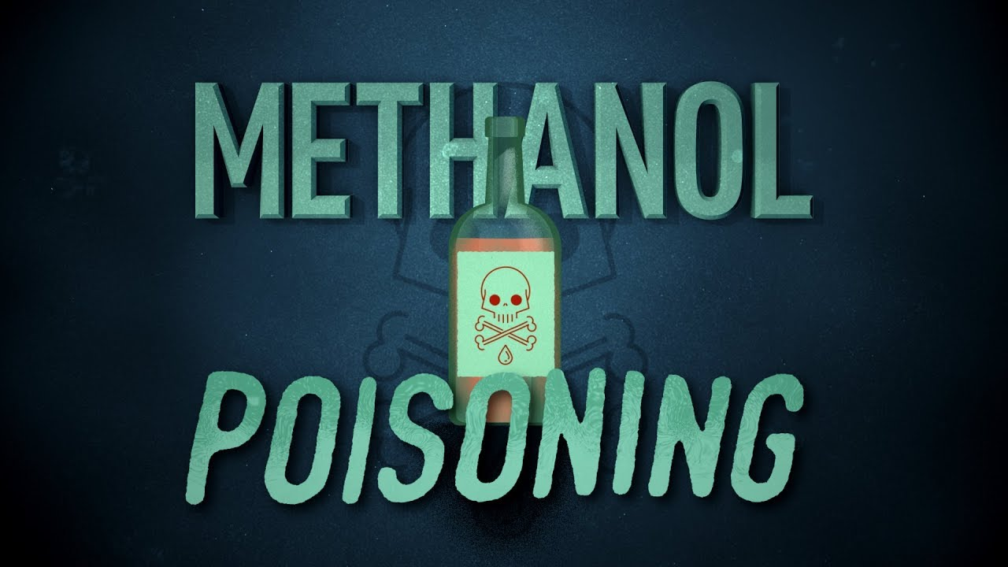

Slide 3
Cause
Methanol Poisoning is mostly caused due to consumption of Alcoholic drinks that have high levels of methanol content due to improper distillation of alcohol.
Even a 20 ml dose of methanol is considered fatal due to its high toxicity in the human body.

Slide 4
Mechanism
In a process of intoxication, methanol is metabolized to formic acid (which is present as the formate ion) via formaldehyde in a process initiated by the enzyme alcohol dehydrogenase in the liver. Methanol is converted to formaldehyde via alcohol dehydrogenase (ADH) and formaldehyde is converted to formic acid via aldehyde dehydrogenase (ALDH). The conversion to formate via ALDH proceeds completely, with no detectable formaldehyde remaining. Formate is toxic because it inhibits mitochondrial cytochrome c oxidase, causing hypoxia at the cellular level, and metabolic acidosis, among a variety of other metabolic disturbances.

Slide 5
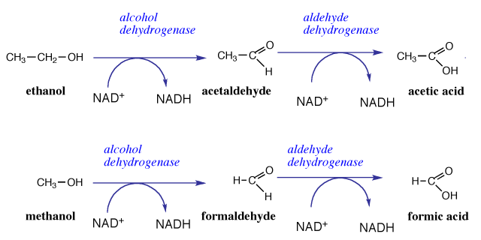
Reactions

Slide 6
Treatment
Methanol poisoning can be treated with fomepizole or ethanol. Both drugs act to reduce the action of alcohol dehydrogenase on methanol by means of competitive inhibition. Ethanol, the active ingredient in alcoholic beverages, acts as a competitive inhibitor by more effectively binding and saturating the alcohol dehydrogenase enzyme in the liver, thus blocking the binding of methanol. Methanol is excreted by the kidneys without being converted into the very toxic metabolites formaldehyde and formic acid. Alcohol dehydrogenase instead enzymatically converts ethanol to acetaldehyde, a much less toxic organic molecule. Additional treatment may include sodium bicarbonate for metabolic acidosis, and hemodialysis or hemodiafiltration to remove methanol and formate from the blood.

Slide 7


Slide 8
Comparing the efficiencies of Ethanol and Fomepizole as Antidotes to Methanol Poisoning
The antidotes work by preventing NAD+ (Nicotinamide Adenine Dinucleotide) from reacting with Methanol by attaching itself to the molecule in the presence of the enzyme ADH (Alcohol Dehydrogenase). Since,the methanol molecule is slightly smaller than the ethanol molecule, ADH consumes methanol at a significantly slower rate. This competitive inhibition is based on the fact that ethanol and fomepizole have higher binding energies with the active binding sites of ADH than methanol has. Using NAMD, we will be calculating these binding energies and finding out which of them is a better antidote to methanol poisoning.

Slide 9
Methodology
To calculate the binding energy of ligands (ethanol and fomepizole) with protein(ADH), we will be using the MMPBSA (Molecular Mechanics Energies combined with Poisson–Boltzmann Surface Area Continuum Solvation) techniques.
We will first solvate the protein along with the ligand and find its energy (G_{PLW}). Then we will remove water from all the frames of the .dcd file formed and average these energies(G_{PL}). After that, we will remove both water and ligand from each frame of the .dcd file and average these energies to get (G_{P}). Next, we find the average of energies found after removing water and protein from each frame of .dcd file (G_{L}). The binding energy (G_{B}) can be calculated as following:
G_{B}=G_{PLW}- G_{PL}- G_{P} - G_{L}

Slide 10


Slide 11
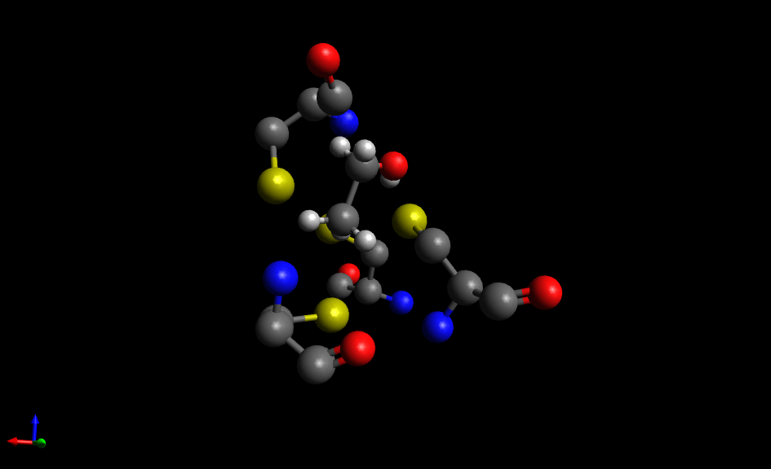
Ethanol in Active Site of ADH

Slide 12
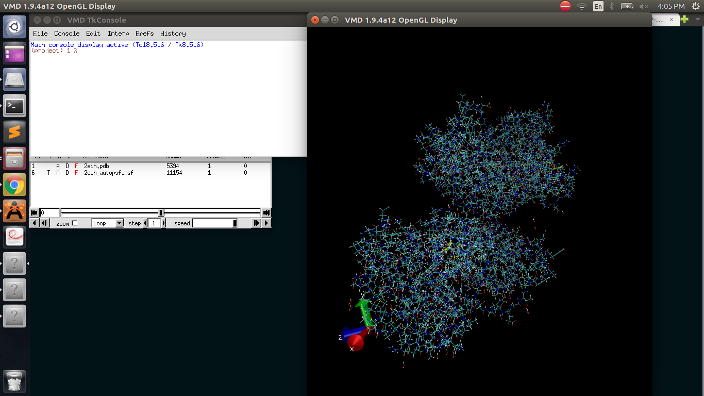
ADH with Ethanol PSF
ADH molecule containing 11,154 atoms

Slide 13
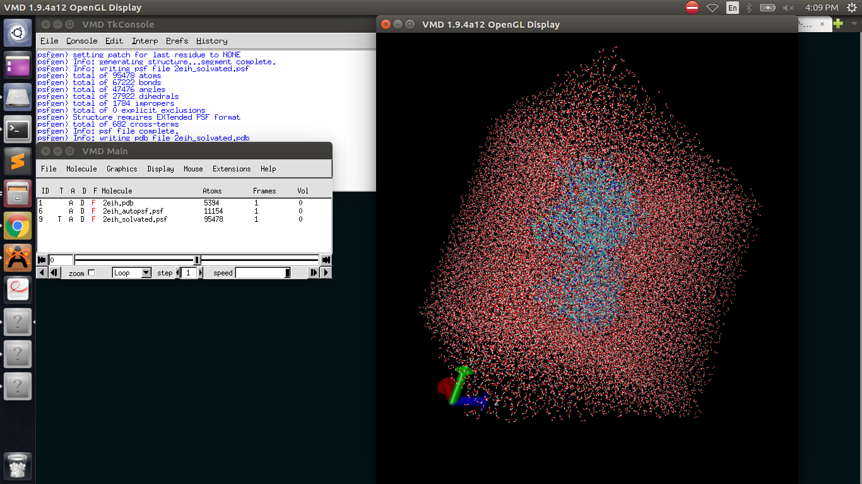
Solvated ADH with Ethanol
The Solvated ADH with Ethanol has 95,478 atoms

Slide 14


Slide 15
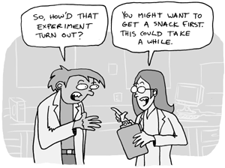

Slide 16
What Next??
We will do the similar process for fomepizole and then use binding energies found to conclude which of the two antidotes is more efficient. The one with higher absolute value of binding energy would bind more to ADH and successively more to NAD+, thus competitively inhibiting Methanol better and thus emerging as a better Antidote!

Slide 17


